Slide 1

CMR Technical Campus Department of Information Technology
Major Project Stage-II Review-1
Project Title: Hybrid AES-ECC Encryption and Image Steganography Framework with MFA for Self-Protector Data Security
Project Supervisor:​
Name:​ M. Ramesh Babu
Designation: Assistant Professor
Presented By:​
Batch No: 6
H. No: 227R1A1221 Name: Hajira Begum
H. No: 227R1A1242 Name: M. Sathvika
H. No: 227R1A1207 Name: Asrith
H. No: 217R1A1296 Name: Ashfaq
​

Slide 2
Index
Introduction
Existing System
Disadvantages of the Existing System
Proposed System
Advantages of the Proposed System
Hardware and Software Requirements
Novelty
System Architecture
Modules
UML diagrams

Slide 3
Introduction​
Data Security is a major challenge in modern communication systems due to increasing cyber threats and data breaches, demanding stronger confidentiality and integrity measures.
Traditional cryptographic methods face issues like high computational cost, scalability limits, and complex key management, especially in low-resource environments.
The Advanced Encryption Standard (AES) ensures fast and efficient symmetric encryption, while Elliptical Curve Cryptography (ECC) offers secure key management.
The hybrid AES-ECC model combines the strengths of both algorithms, enhancing encryption performance and key exchange security.
To strengthen protection further, image steganography conceals encrypted data within images, making it invisible to attackers and ensuring multi-layered data security.

Slide 4
Existing System
The existing system uses a traditional security approach that focuses mainly on encrypting data at rest or in transit with basic access controls. This single-layer protection offers limited defense against advanced cyberattacks.
It relies on an assumed-trust model where data is stored on remote servers controlled by service providers. Encryption keys are often stored on the same server, increasing the risk of insider attacks.
Encrypted files are clearly identifiable, making them attractive targets for attackers. The system does not include data concealment techniques, allowing adversaries to easily locate sensitive information.
Access control is usually based on single-factor authentication, such as usernames and passwords. This weak mechanism is vulnerable to credential theft, brute-force attacks, and lacks adaptability to evolving security threats.

Slide 5
Disadvantages of Existing System
.
Susceptible to insider threats due to insufficient access control mechanisms.
Presence of a single point of failure affects overall system reliability.
Lack of effective data concealment increases the risk of data leakage.
Limited capability to adapt to evolving and advance security threats.
Absence of multi-layered security reduces overall protection strength.

Slide 6
Proposed System
The proposed system is a multi-layered security framework designed to protect data in untrusted environments. It employs hybrid AES-ECC encryption, where files are encrypted with symmetric AES key and securely wrapped using the recipient’s ECC public key, preventing any single entity from accessing both components .
To further conceal sensitive information, the encrypted data is embedded within ordinary images using steganography, making it nearly undetectable.
Access is secured through Multi-Factor Authentication (MFA), requiring both user credentials and one-time password (OTP), ensuring robust end-to-end protection.

Slide 7
Advantages of Proposed System
Enhanced Confidentiality and efficiency
Effective Insider Threat Mitigation
Superior Security Through Obscurity
Robust Access Control
Data Integrity Assurance
Adaptability to Modern Threats
User Awareness and Proactive Security

Slide 8
System Requirements
Hardware Requirements
Processor: Intel i5
• Memory: 512
• RAM: 8 GB
Software Requirements
• Python 3.7.6
• Operating system: Windows
• Frontend: Tkinter
• Database: MySQL

Slide 9
Novelty
This project introduces a secure data protection framework by integrating multiple security techniques instead of relying on a single encryption method. AES is used for fast data encryption, while ECC ensures secure key management, providing both efficiency and strong security.
The system further enhances protection by applying image steganography after encryption. Encrypted data is embedded within digital images, concealing the presence of sensitive information and reducing the risk of detection or interception.
Security is strengthened through the use of OTP-based Multi-Factor Authentication. This ensures that only verified users can access encryption, decryption, and data retrieval operations.
Overall, the framework delivers an end-to-end secure solution using Django and MySQL, making it suitable for real-world cloud and network security applications.

Slide 10
System Architecture
The proposed framework follows a layered design to ensure secure and efficient data handling. The User Interface Layer provides a web-based platform for user authentication, file upload, and secure data retrieval.
The Application Layer, implemented using the Django framework, manages user sessions, request routing, and access control. It coordinates communication between the frontend, security modules, and storage components.
All security-related operations are handled by a dedicated Security Layer. This includes hybrid AES–ECC encryption, image steganography for data concealment, and OTP-based multi-factor authentication.
The Storage Layer is divided into a relational database for metadata storage and a secure file system for protected steganographic files. This separation ensures confidentiality, concealment, and controlled access to sensitive data.

Slide 11
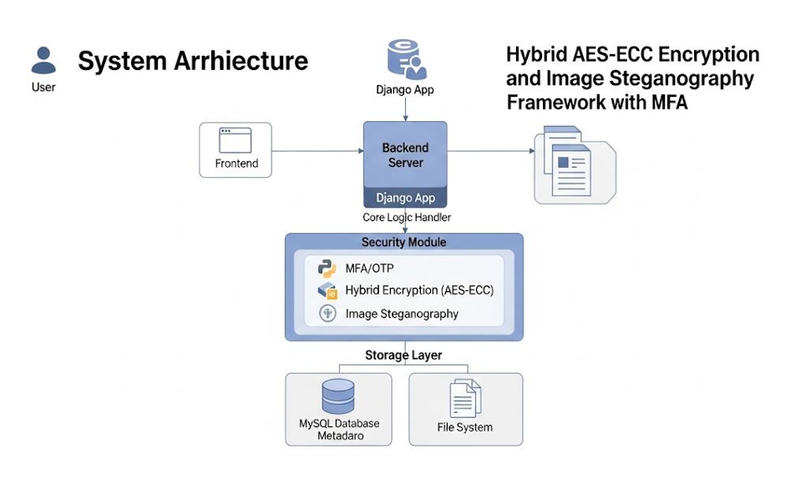
System Architecture
System Architecture

Slide 12
Modules
1. User Registration Module :
- New User signup
- Stores user details securely in database
2. User Authentication and MFA Module :
- Username and password login
- OTP generation and email verification
3. Encryption Module: - Encrypts user files or messages using AES/ECC
- Provides fast and secure encryption

Slide 13
Modules
4. Image Steganography Module:
- Encrypts data into images
- Produces visually unchanged stego – images
5. File upload and Download Module :
- Handles secure upload of file
- Allows authorized retrieval only

Slide 14
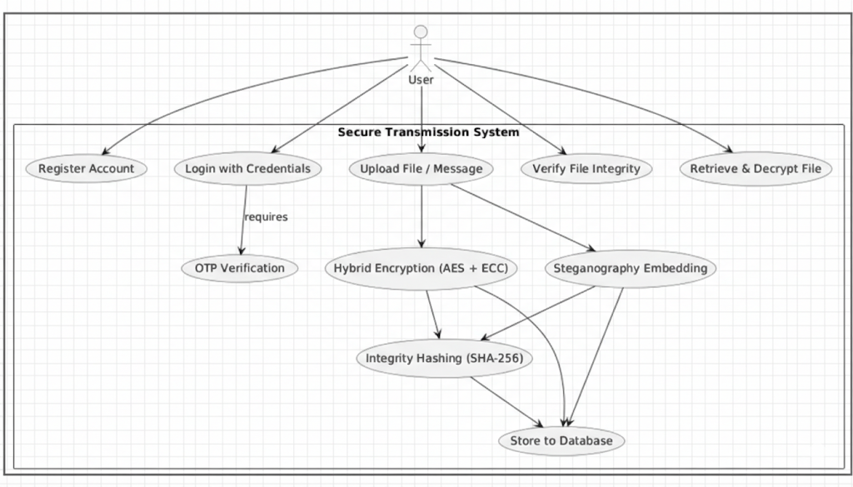
UML Diagrams
Use Case Diagram

Slide 15
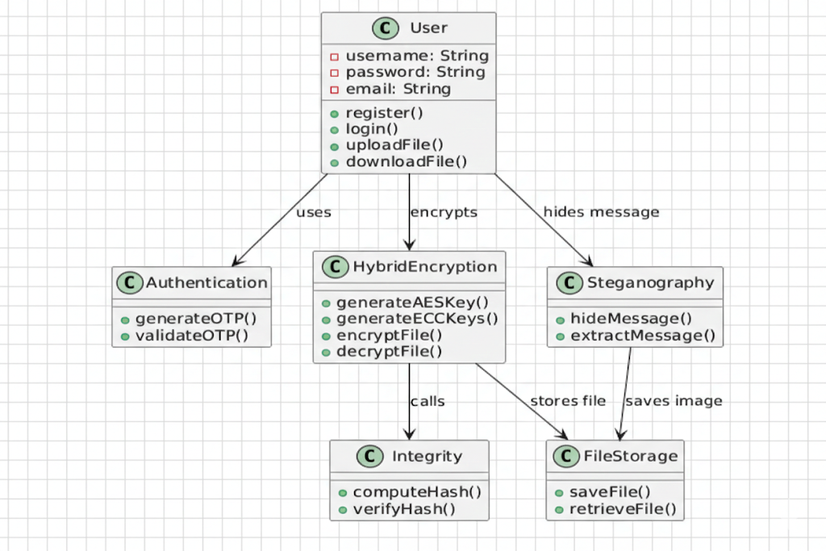
Class Diagram

Slide 16
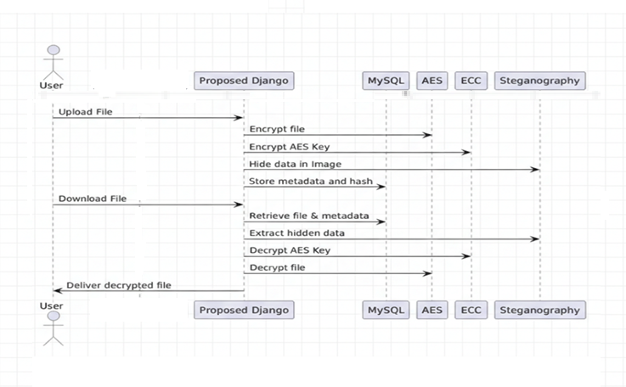
Sequence Diagram

Slide 17
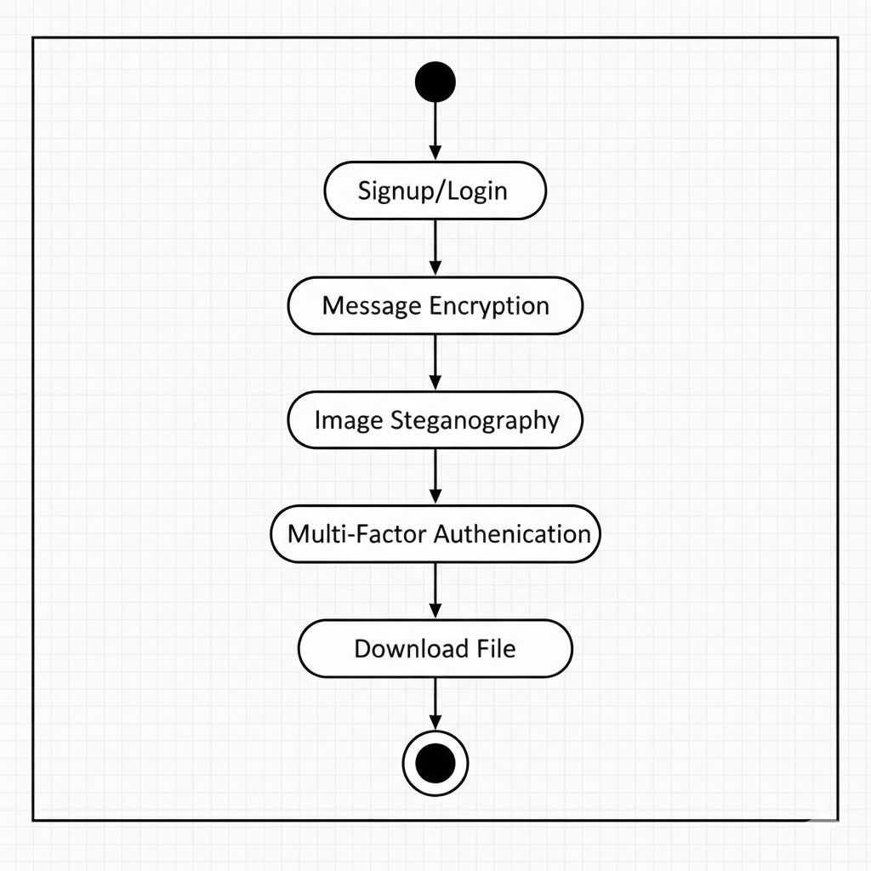
Activity Diagram

Slide 18
THANK YOU

